Slide 1
Forest resources

Slide 2
Forest resources
Forests are the most diverse ad widespread ecosystems on the earth and perform valuable functions.
India should ideally have 33 percent of its land under forest cover. Today we have only 23 percent land under forest cover.
Thus we need not only to protect forest but also to increase our forest cover.
Forest resources provide valuable products such as timber, food , drugs as well as provide shelter for wild animal.

Slide 3
Forest: It is defined as communities of plant predominantly of trees and other woody vegetation usually with a closed canopy.
It is also defined as a area set aside for the production of timber and other forest products or maintained under woody vegetation for certain indirect benefits.
Forest is composed of many plant species which may be of principal, accessory or auxiliary species
Principal species = Most important species in a mixed forest either by volume or value.
Accessory species = Useful species less than principal species.
Auxiliary species = species of inferior quality in the forest.

Slide 4
Classification of forest
Classification is based on composition, age, climatic elements, structure , habitat etc. According to Champion and Seth classification 1935:
Tropical wet evergreen forest
1a. Southern wet evergreen forest = Maharashtra, TN, Kerala, Karnataka , Andamans.
MAT = 27 C
MARF= 2000 TO 3000 mm
Species = Dipteocarpus, Mesua, Hopea, Artocarpus, Bamboo, Palms, Ferns, Orchids.

Slide 5
1b. Northern tropical wet evergreen forest = NE India, West Bengal, Assam, Odisha
MAT = 22- 26 C
MARF = 2500 – 6000 mm
Species = Dipterocarpus, Mesua, Michelia, Dendrocalamus etc.
2. Tropical Semi Evergreen forest
2a. Southern TSEF = Western Ghat, Karnatka, Kerala
MAT=26 C
MARF= 2000 to 3000 mm
Species = Diptercarpus, Hopea etc.
2b. Northern TSEF= Asaa, West Bengal, Coastal part of Odisha
MAT = 24 C
MARF= 1500 to 3000 mm.
Species = Dipterocarpus, Michelia, Artocarpus, Polyalthia
3. Tropical moist deciduous forest-
3a. Andamans TMDF = Andaman Island
= MAT = 26 C, MARF = 3000 mm
Species = Pterocarpus, Terminalia, Ixora etc.
3b. South Indian TMDF= Gujrat, Karnatka, Maharashtra, TN,
MAT = 24 to 27 C, MARF = 1200 to 3000 mm
Species: Teak, Grewia, Terminalia , Dillenia etc.

Slide 6
3c. North India TMDF = U.P. Bihar, Odisha, M.P., Bengal, Assam.
MAT= 21 to 26 C, MARF = 1000 to 2000 mm
Species = Terminalia, Michellia, Sal etc.
4. Littoral and swamp forest = coastal region, estuaries of river, Along Ganga and Brahmaputra river.
MAT= 26 to 29
MARF= 760- 5000 C
Species = Causarina, Manilkara, Calophyllum etc.
5. Tropical dry deciduous forest = M.P., A.P., Gujarat, Karnatka, U.P. , Bihar, Odisha, West Bengal.
MAT= 23 to 29 C
MARF= 750 to 1900 mm
Species= Teak, Sal,
6. Tropical Thorn Forest = M.P., Semi Arid area of Punjab, Rajasthan gujarat
MAT = 24 to 28 C
MARF = 460 to 1250 mm
Species = Acacis, Prosopis,

Slide 7
7. Tropical dry evergreen forest = coastal belt from Tirunveli to Nellore
MAT= 28 to 29 C
MARF= 870-1270 mm
Species = Mailkara, Canthium etc.
8. Sub tropical Broad leave hill forest = South Indian hills and eastern himalayas and Khasi hills.
MAT= 17 to 22 C
MARF= 1500-6600 mm
Species= Mangifera, Castonopis etc.
9. Sub tropical pine forest = Central Himalayas, Manipur Hills
MAT = 16 to 20 C
MARF = 1000 to 3000 mm
Species = Chir, Deodar, Kail, Rhododendron
10. Sub tropical dry evergreen forest = Himalayas
Species = Acacia modesta

Slide 8
11. Montane wet temperate forest= Hills of TN and Kerala
MAT= 14 TO 17 C
MARF= 1300 TO 6000 mm
Species = Rhododendron, Michelia
12. Himalayan moist temperate forest
13. Himalayan dry temperate forest
14. Sub Alpine forest
15. Moist Alpine
16. Dry Alpine Scrub

Slide 9
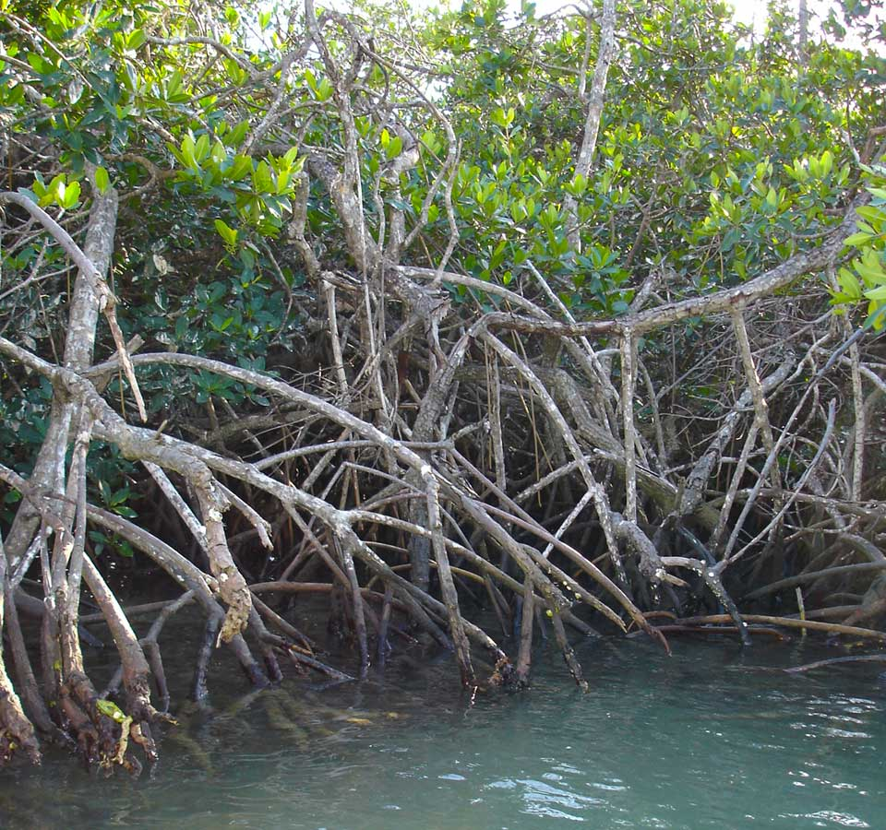
There are about 80 different species of mangrove trees. All of these trees grow in areas with low-oxygen soil, where slow-moving waters allow fine sediments to accumulate.
Mangrove forests only grow at tropical and subtropical latitudes near the equator because they cannot withstand freezing temperatures.
Many mangrove forests can be recognized by their dense tangle of prop roots that make the trees appear to be standing on stilts above the water.
This tangle of roots allows the trees to handle the daily rise and fall of tides, which means that most mangroves get flooded at least twice per day. The roots also slow the movement of tidal waters, causing sediments to settle out of the water and build up the muddy bottom.
Mangrove forests stabilize the coastline, reducing erosion from storm surges, currents, waves, and tides. The intricate root system of mangroves also makes these forests attractive to fish and other organisms seeking food and shelter from predators.

Slide 10
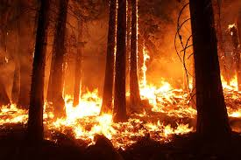
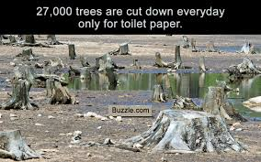
Causes of forest depletion
Rapid Industrialization
Urbanization
Agriculture
Mining
Construction of DAM
Overgrazing

Slide 11
Consequences of Forest depletion
Food problems: Most of the area that has undergone deforestation is actually unsuitable for long-term agricultural use such as ranching and forming. Once deprived of their forest cover, the lands rapidly degrade in quality, losing their fertility and arability.
Exposing Soil to heat and rain: Heavy rainfall and intense sunlight damage the top soil. In such conditions, land loses its fertility.
Flood : Deforestation results to watersheds that are no longer able to sustain and regulate water flows from river to streams. Trees are highly effective in water absorption. In absence of forest too much water can results to downstream flooding.

Slide 12
Loss of Biodiversity
Displacement of Indigenous communities
Economic loss
Climate Change
Health Issue

Slide 13
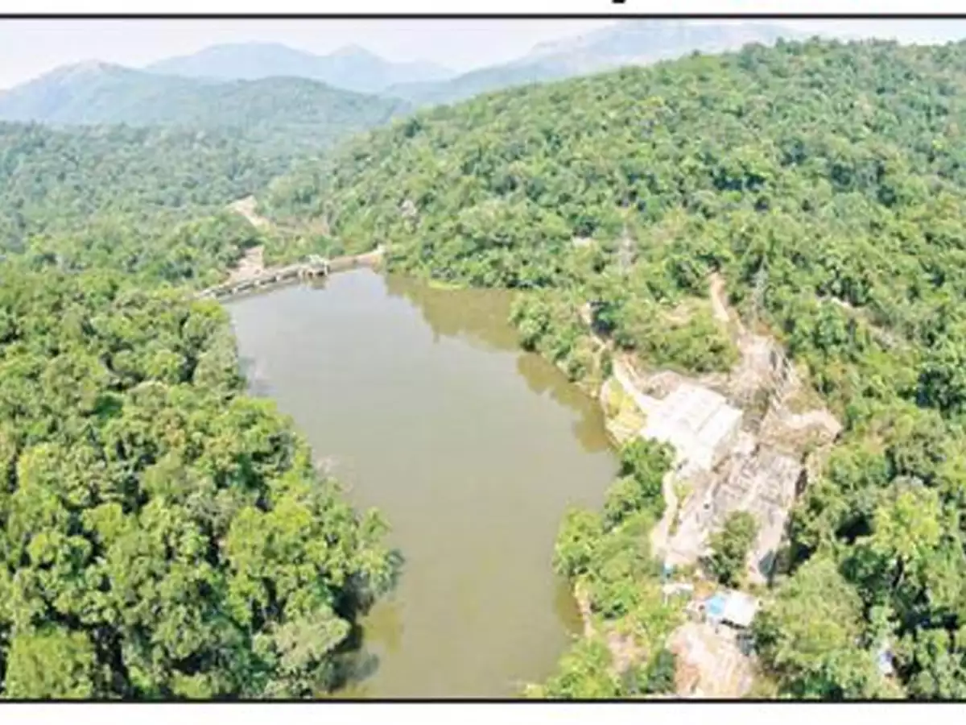
Impact of Dams on Forest Cover
While India has been pushing for hydropower development, a latest study in Kinnaur district of Himachal Pradesh on forest land diverted for hydropower projects has revealed that construction activities for hydropower are threatening biodiversity, impacting indigenous people and fragmenting critical wildlife habitats.
Under the Forest Conservation Act 1980, forest areas are diverted for non-forest activities like hydropower projects and then plantation has to be carried out to compensate for the loss of the forest. The study revealed that in the area examined for the study, the plantations have so far, “only been undertaken over 12 percent of the planned area, and even these had a survival rate of less than 10 percent.”

Slide 14
